Slide 1
J-K Flip-Flop
Joshua Gould
12/5/2017
ECE 09.414 VLSI Design
Dept. of ECE
Henry M. Rowan College of Engineering
Rowan University

Slide 2
Outline
J-K Flip-Flop Overview / Description
Features / Problems
Block Diagram
Truth Table
Master Slave Design
Design Choices
Logical Design
Worst Case Design
Logical Effort, Number of Stages, Delay
Gate Sizes for Optimized Design
Standard Cell Library & Layout Simulations
Conclusion

Slide 3
Overview
JK Flip-Flop with Clear
  like the SR flip-flop, includes a "toggle" function when inputs are set to 1.
  Outputs only change with a clock pulse (Synchronous)
J (set) and K (reset)
  In other words:
  J=1, K=0 sets the flip-flop
  J=0, K=1 resets the flip-flop
  J=1, K=1 toggles the flip-flop

Slide 4
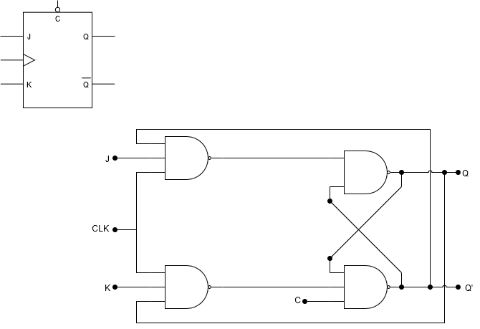
Block Diagram

Slide 5
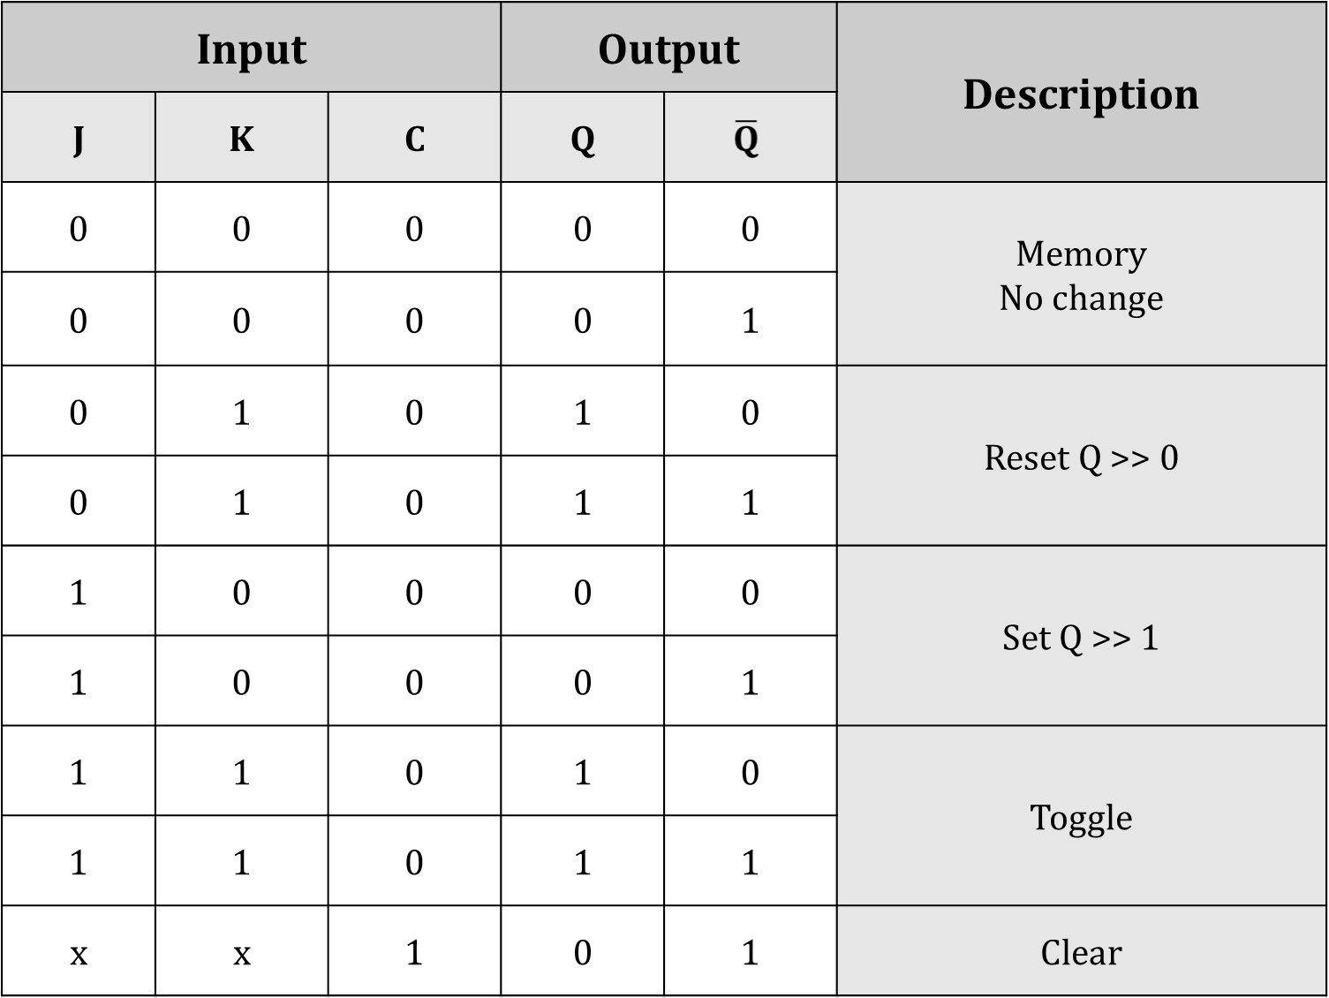

Slide 6
Basic JK Flip-Flop
suffers from timing problems called “race”
Race timing occurs if the output Q changes state before the timing pulse of the clock input has time to go “OFF”.
To avoid this the timing pulse period ( T ) must be kept as short as possible (high frequency).
Master-Slave JK Flip-flop was developed.

Slide 7
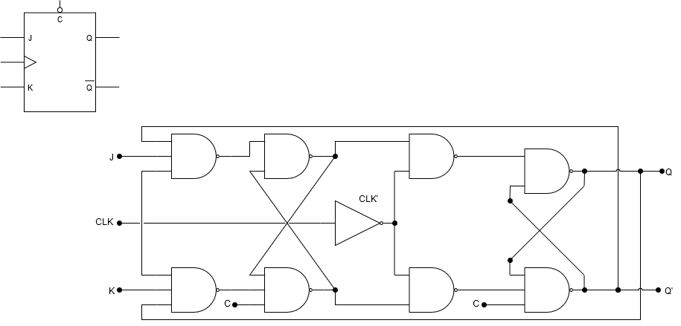
Master/Slave Flip-Flop
Master Latch
Slave Latch
Two latch stages in a cascaded configuration
Activated with opposite clock phases
Eliminates uncontrolled oscillations since only one stage is active at any given time

Slide 8
Design Overview
POSSIBILITY 1: Simple NAND Logic Gate
  PROS:
    Simple design
    Small design area
    Easily understandable
  CONS:
    Possible timing issues
    This places some stringent constraints on the clock pulse width (e.g. less than the propagation delay through the FF)
    38 Transistors Required

Slide 9
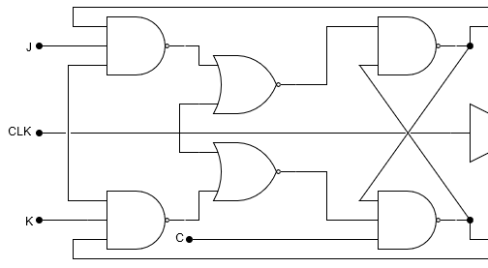
Design Overview
POSSIBILITY 2.1: Edge Triggered NAND-NOR
  PROS:
    Edge-triggered
    Easily understandable
  CONS:
    Inputs must be stable
    for some time before
    clock goes low.
    Larger design area than NAND only (+2 NOR +2 NOT)
    44+ Transistors Required (Highest)
    Timing is slower

Slide 10
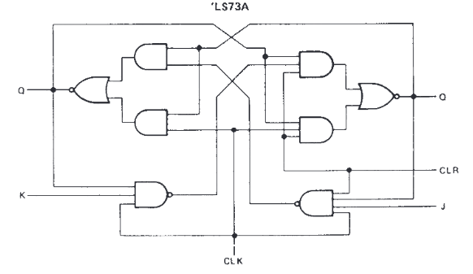
Design Overview
POSSIBILITY 2.2: LS73A Based
  PROS:
    Edge-triggered
    Professional Based
    Fast Switching
  CONS:
    Inputs must be stable
    for some time before
    clock goes low.
    Larger design area than NAND only (+4 AND +8 NOT)
    Timing is slower
    Power consumption is higher

Slide 11
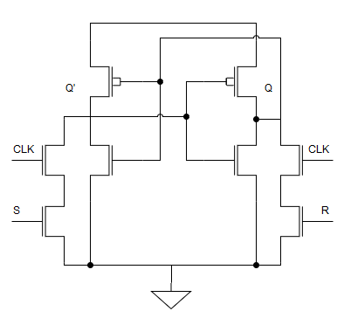
Design Overview
POSSIBILITY 3: Pass Transistors
S
R

Slide 12
Design Overview
POSSIBILITY 3: Pass Transistors
  PROS
    18 Transistors
    Smallest Logic Area
  CONS
    Additional components in
    latch area
    Bad for pull-up level

Slide 13
Logic Design

Slide 14
Worst Case Logical Path

Slide 15
Logical Effort, Number of Stages, Delay

Slide 16
Spreadsheet Comparing Different Designs

Slide 17
Gate Sizes for Optimized Design

Slide 18
Standard Cell Library

Slide 19
Standard Cell Library Layouts

Slide 20
Standard Cell Library Extracted Layouts

Slide 21
Standard Cell Library Simulation
“Spectre” Netlist

Slide 22
Standard Cell Library Simulation
Input / Output Waveforms

Slide 23
Snap-together Standard Cells
Circuit Layout

Slide 24
Snap-together Standard Cells Simulation
Input / Output Waveform

Slide 25
Delay Comparison
Logical Effort vs. Spectre

Slide 26
Conclusions

